Slide 1
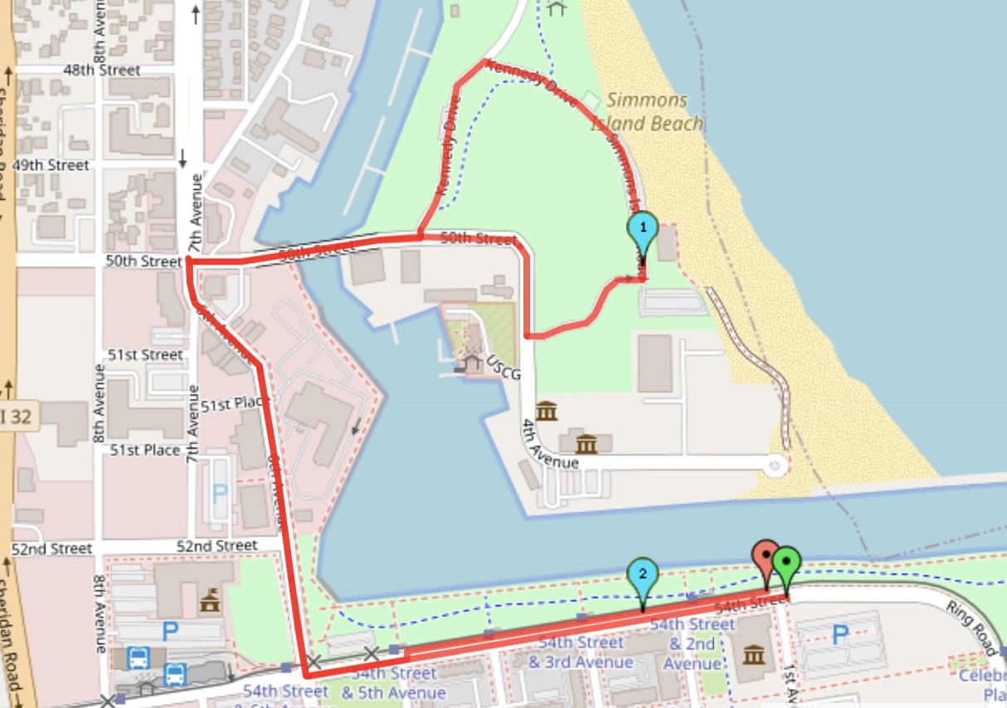
2 MILE
Start on 54th St & 1st Ave.
Runners will head west on 54th, right on 6th, right on 50th, then a right on 4th and left down the hill towards Simmons Island Beach House, stay to the left and left on Kennedy Dr. a right back to 50th heading west. Left on 7th on the west side of the road and
back to the finish.

Slide 2
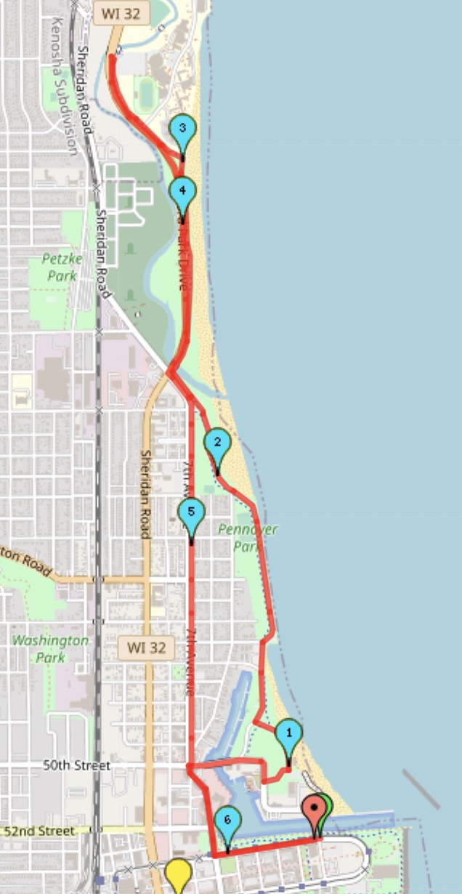
10K
Start on 54th St & 1st Ave.
Runners will head west on 54th, right on 6th, right on 50th, then a right on 4th and left down the hill towards Simmons Island Beach House, right turn on Kennedy Dr. Runners will stay on Kennedy Dr heading north and jump on the bike path right before Alford Park Dr. heading north. At the parking lot for Tarble Arena the runners will make a U turn on to Alford Park Dr. heading south on the eastbound lane. Runners will make a left on 7th ave on the southbound lane and back on top 6th Ave and back to the start/finish line.

Slide 3
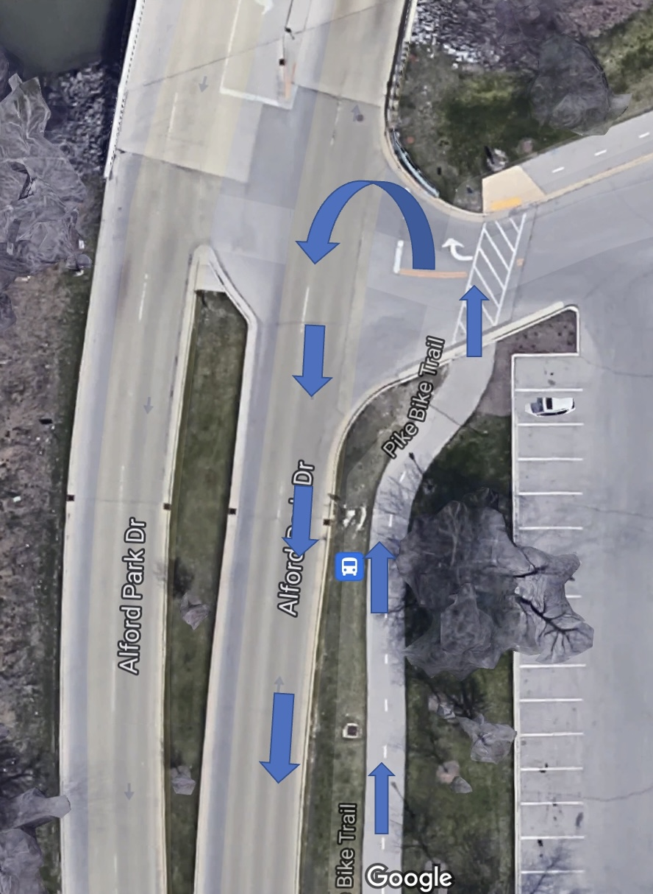
Carthage turnaround

Slide 4
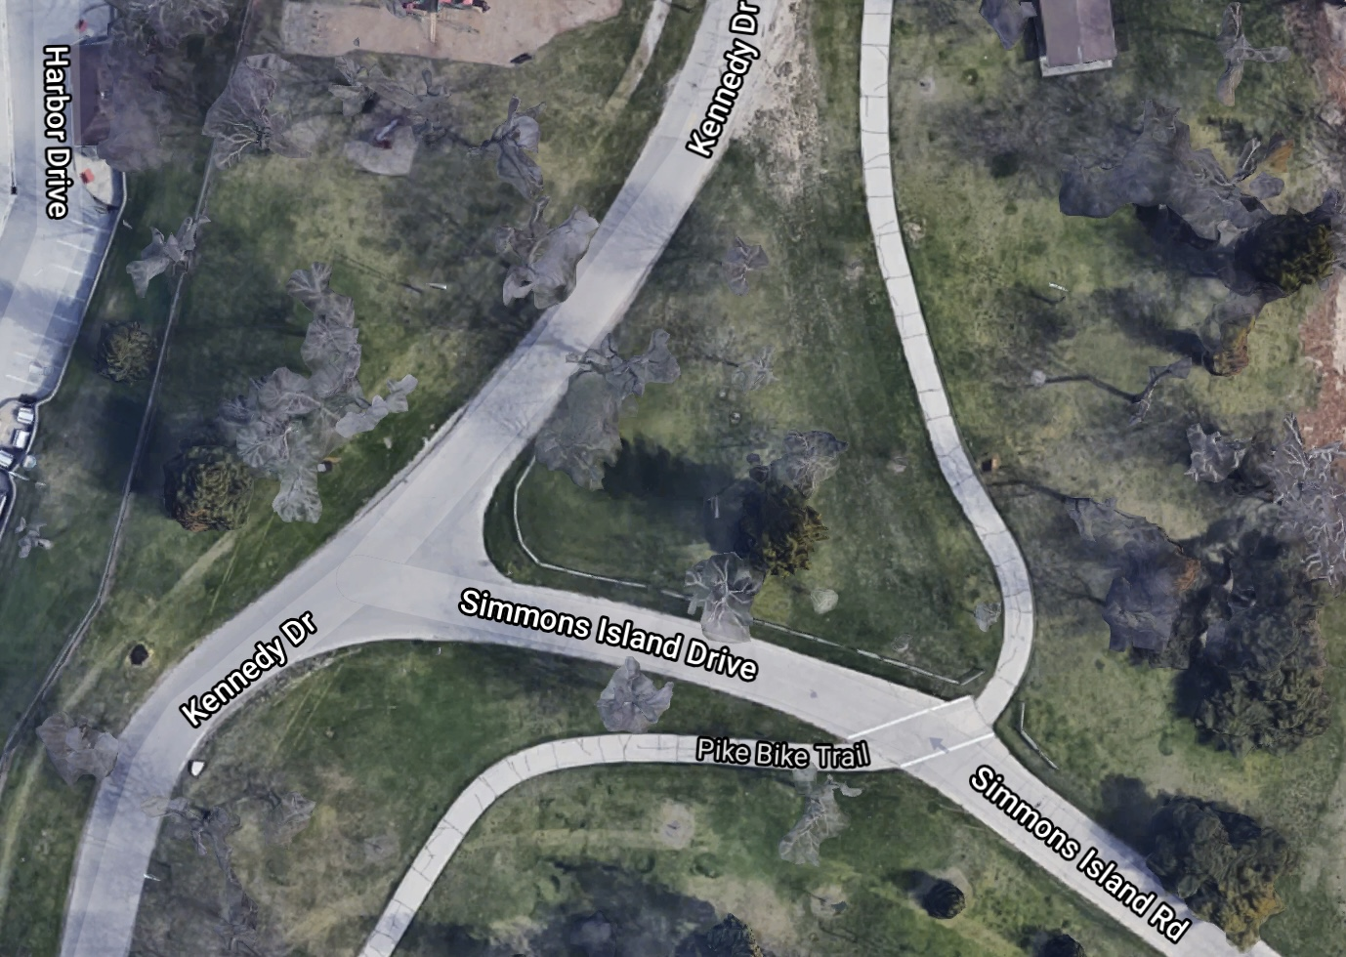
2mile/10K split
Yellow = 10k
Blue = 2mile

